Slide 1
CS-M67
Lecture 2:
Texture
Mapping
Dr. Benjamin Mora
University of Wales Swansea
Benjamin Mora

Slide 2
Content
Texture Mapping at the very beginning.
Perspectively Correct Texture Mapping.
Texture Filtering.
Muti-Texturing.
Texture Mapping as an n-Dimensional function.
Other use of Texture Mapping.
  Spherical and Cube mapping.
  Shadow Mapping
  Bump Mapping
University of Wales Swansea
Benjamin Mora

Slide 3
Texture Mapping at the very beginning
University of Wales Swansea
Benjamin Mora

Slide 4
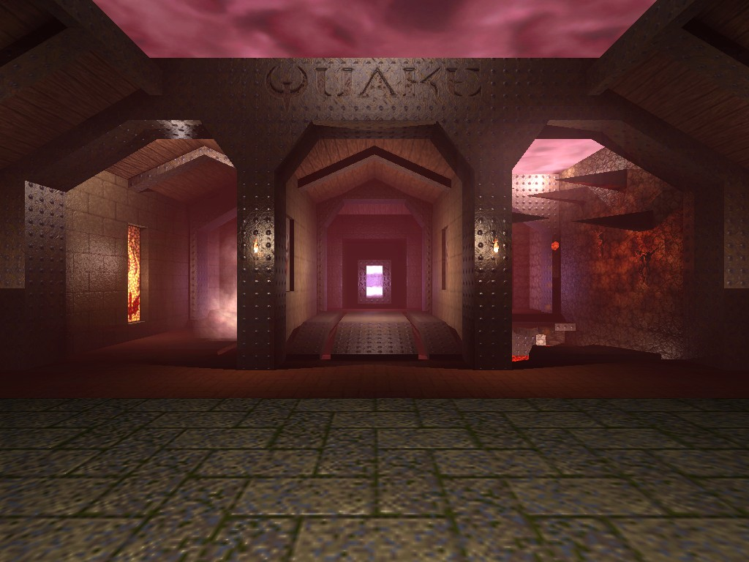
Texture Mapping
University of Wales Swansea
Benjamin Mora

Slide 5
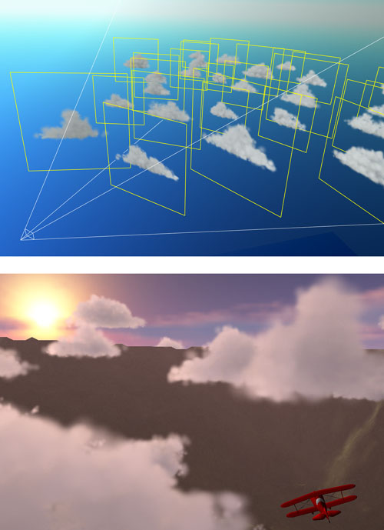
Texture Mapping
University of Wales Swansea
Benjamin Mora

Slide 6
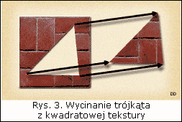
Texture Mapping
Initial Goal: Get surfaces that look more realistic by mapping images (textures) on the primitives of the scene.
Usually 2D, but textures can also be 1D or 3D.
For every vertex, the programmer must specify its coordinates inside the texture/image.
University of Wales Swansea
Benjamin Mora
Notes:
A texture is just an image…

Slide 7
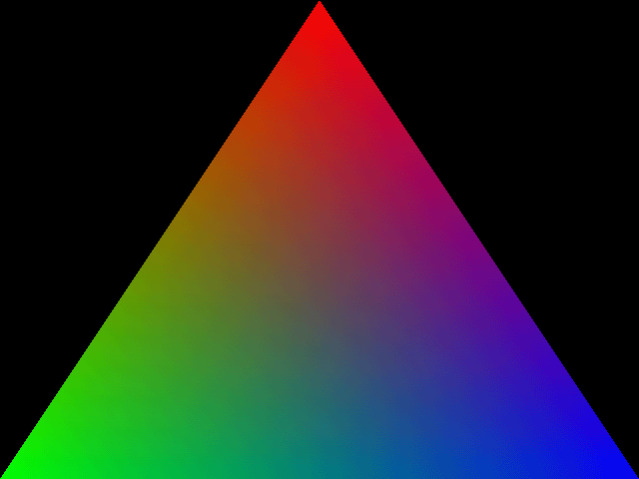
Texture Mapping Coordinates
n-Dimensional (Usually 2D) texture coordinates are provided for every vertex of the 3D Mesh.
  Coordinates usually considered between 0 and 1.
Texture coordinates are then (more or less linearly) interpolated inside the triangle at the intersection point.
p₀
v_{dir}
p(t)
Rasterization
Ray-tracing
Linear Interpolation
University of Wales Swansea
Benjamin Mora
Notes:
The rasterization is done using a scan-line algorithm. The color interpolation is done by using the barycentric coordinates.
Add Bresenham's line algorithm later on (more information at http://en.wikipedia.org/wiki/Bresenham's_line_algorithm)
Add coordinates between 0 and 1…

Slide 8
Texture Mapping Coordinates
(0.5, 1)
(1, 1)
(0.5, 0.333)
(1, 0)
(0, 0)
(0, 0)
Texture
University of Wales Swansea
Benjamin Mora
Notes:
The rasterization is done using a scan-line algorithm. The color interpolation is done by using the barycentric coordinates.
Add Bresenham's line algorithm later on (more information at http://en.wikipedia.org/wiki/Bresenham's_line_algorithm)
Add coordinates between 0 and 1…

Slide 9
Linear Interpolation inside a simplex
Simplex= A n-dimensional generalization of a triangle.
  n=1 => a line.
  n=2 => a triangle.
  n=3 => a tetrahedron.
Linear Interpolation inside a triangle:
f₁
α
β
f₁₂= (1- α) f₁ + α f₂
f₁₃= (1- β) f₁ + β f₃
f₁₂₃
f₁₂
γ
f₁₃
f₁₂₃= (1- γ) f₁₂ + γ f₁₃
0 ≤ α, β, γ ≤ 1
f₂
f₃
University of Wales Swansea
Benjamin Mora

Slide 10
Linear Interpolation inside a simplex
Properties
  The weights of f1,f2,f3 represent the barycentric coordinates.
  The set of points having the same interpolated value (isosurface) represents a line
  Extension to 3D (tetrahedron) is trivial
    The set of points having the same interpolated value (isosurface) represents a plane.
3
f₁₂₃=((1- α)(1-γ)+(1- β)γ ) f₁ + (α)(1-γ) f₂ + βγ f₃
f₁₂₃=a₁f₁+a₂f₂ +a₃f₃, with a₁+a₂+a₃=1
Isosurface (f=5)
7
6
University of Wales Swansea
Benjamin Mora

Slide 11
Texture Mapping on graphics cards
OpenGL interpolates the texture coordinates for every rasterized fragment and then fetch the pixel from the texture.
Textures are stored on the graphics board memory and are highly optimized.
  Huge memory bandwidth thanks to specialized hardware.
University of Wales Swansea
Benjamin Mora

Slide 12
Perspectively correct Texture Mapping
University of Wales Swansea
Benjamin Mora

Slide 13
Issue With Graphics Hardware TM
Ray-Tracing interpolates texture coordinates at the (3D) intersection.
Basic Graphics Hardware would project the triangle first on the image plane, and then linearly interpolate coordinates & color.
  Incorrect due to the non-linearity aspect of perspective projection.
Distance Ratio!=0.5
v_{dir}
View Point
Distance Ratio=0.5
Image Plane
University of Wales Swansea
Benjamin Mora

Slide 14
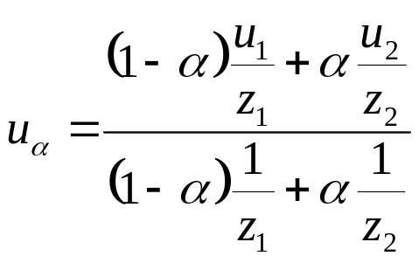

Issue With Graphics Hardware TM
Correct coordinate Interpolation:
Biased estimation:
A texture coordinate
Vertex Depth
p₁(u₁, z₁)
View Point
α
p₂(u₂, z₂)
University of Wales Swansea
Benjamin Mora

Slide 15
Texture Filtering
University of Wales Swansea
Benjamin Mora

Slide 16
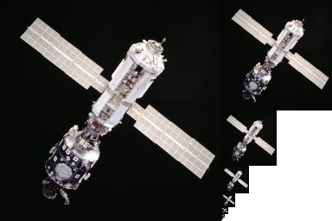
Texture MIP-Mapping
Mipmap textures are used to decrease the bandwidth required to load the texture and to improve cache coherence.
Can also improve quality for objects that are far away.
Pixels
http://en.wikipedia.org/wiki/Mipmap
University of Wales Swansea
Benjamin Mora

Slide 17
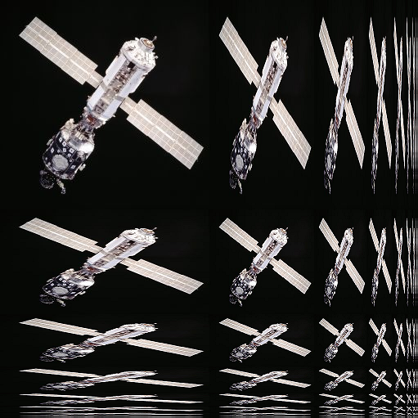
Texture MIP-Mapping (Anisotropic)
http://en.wikipedia.org/wiki/File:MipMap_Example_STS101_Anisotropic.png
University of Wales Swansea
Benjamin Mora

Slide 18
Texture MIP-Mapping
Mipmaps can be automatically generated or specified by the programmer.
Texture are always magnified or minified.
Bilinear, trilinear or anisotropic filtering helps when the texture is magnified.
Issue with MIP-Mapping:
  Transition between Mipmap levels can be visible inside the image.
  Tri-linear texture filtering reduces the artefact by interpolating texels from the 2 closest mipmap levels.
University of Wales Swansea
Benjamin Mora
Notes:
Context for this slide: 3D Graphics hardware

Slide 19
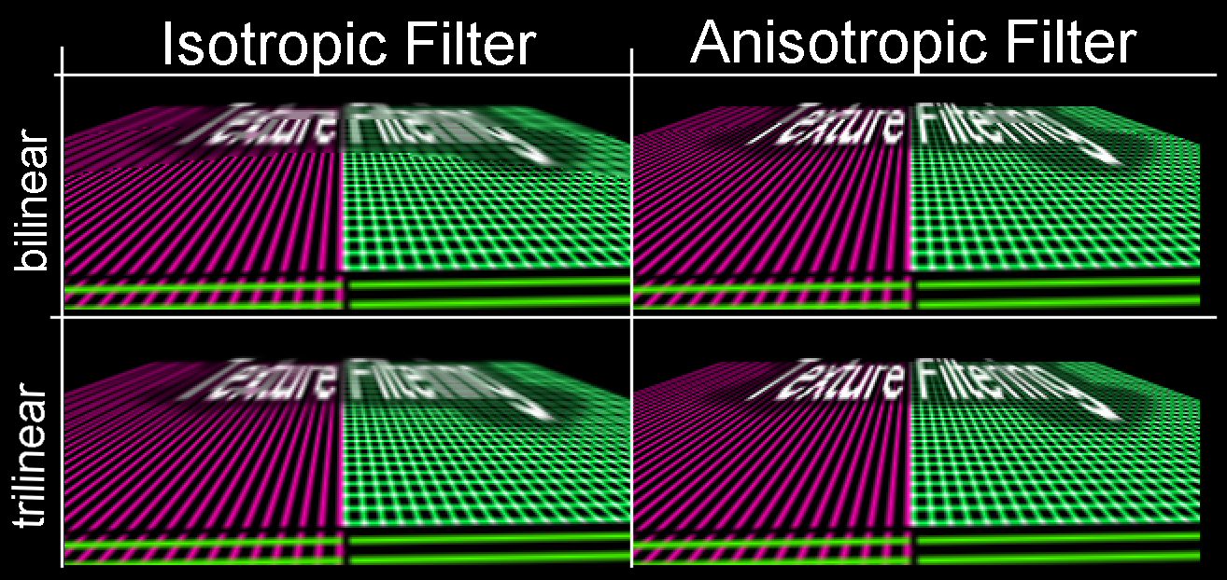
Texture MIP-Mapping
http://developer.nvidia.com/object/Anisotropic_Filtering_OpenGL.html
University of Wales Swansea
Benjamin Mora

Slide 20
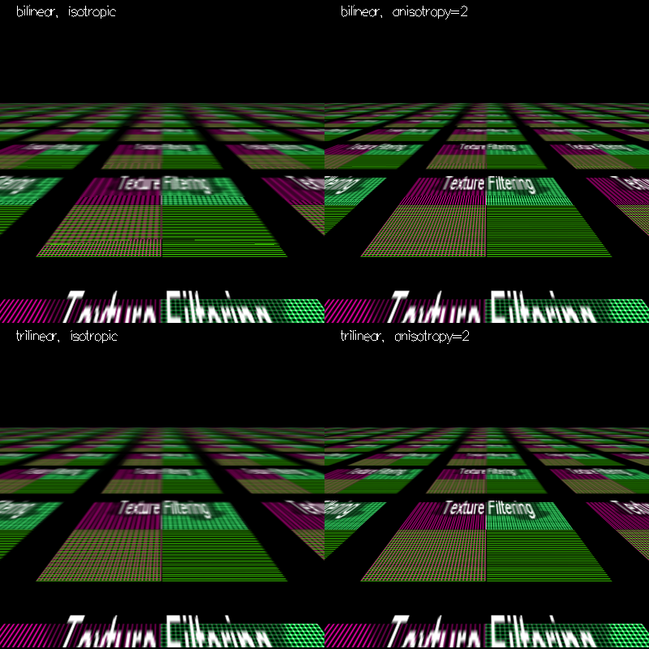
Texture MIP-Mapping
http://developer.nvidia.com/object/Anisotropic_Filtering_OpenGL.html
University of Wales Swansea
Benjamin Mora

Slide 21
Multi-Texturing
University of Wales Swansea
Benjamin Mora

Slide 22
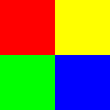
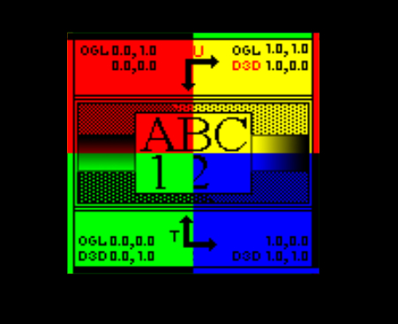
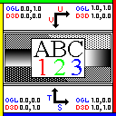
Multi-Texturing: Example
*
University of Wales Swansea
Benjamin Mora

Slide 23
Multi-Texturing
Multiple ways to blend textures.
  Originally additive or multiplicative was supported on Graphics hardware.
  Arbitrary blending is now possible on Graphics hardware with the use of fragments program.
Most games/software nowadays makes use of several textures.
University of Wales Swansea
Benjamin Mora

Slide 24
Texture Mapping as an n-Dimensional function
University of Wales Swansea
Benjamin Mora

Slide 25
TM as an n-Dimensional function
Concept of texturing can be extended, and textures can be 1D, 2D, 3D.
A texture can be seen as a way to represent a 1D, 2D or 3D function.
  f(x), f(x,y), f(x,y,z).
  Bounded interval (eg. [0..1, 0..1] in 2D).
  Regular interval sampling.
Can be used to represent anything…
  Vertex displacement.
  Noise.
  Shading function (E.G., BRDFs).
University of Wales Swansea
Benjamin Mora

Slide 26
1D Textures
Useful for representing things like
  Hair and line texturing.
  1D functions not implemented on hardware
    E.g. ArcTan.
  Look-up tables.
  Arbitrary data in 1D arrays.
University of Wales Swansea
Benjamin Mora

Slide 27
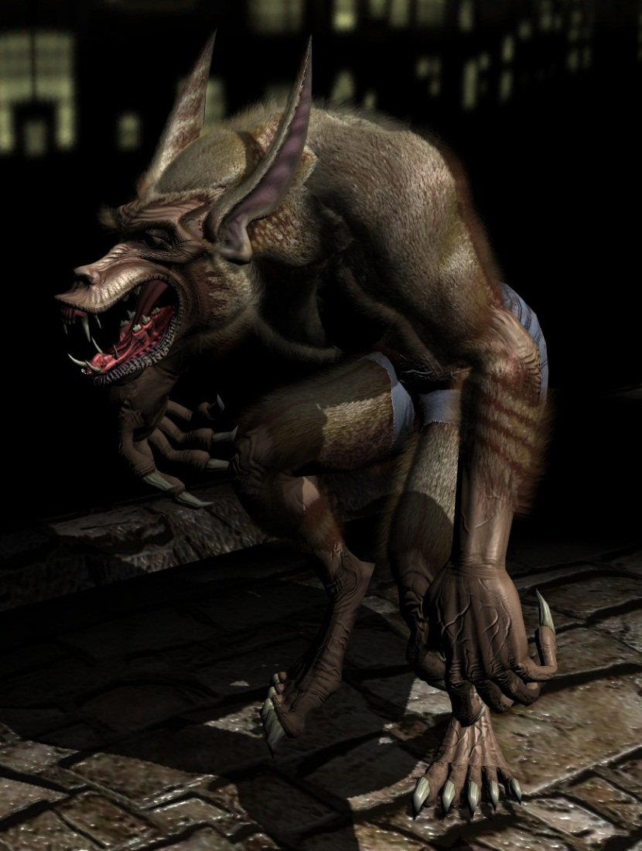
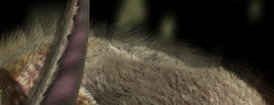
3D Textures
Useful for representing things like
  Marble
  Fire
  Fog
  Fur
From NVidia Demo, Werewolf
University of Wales Swansea
Benjamin Mora

Slide 28
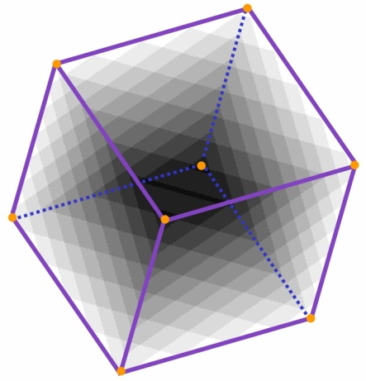
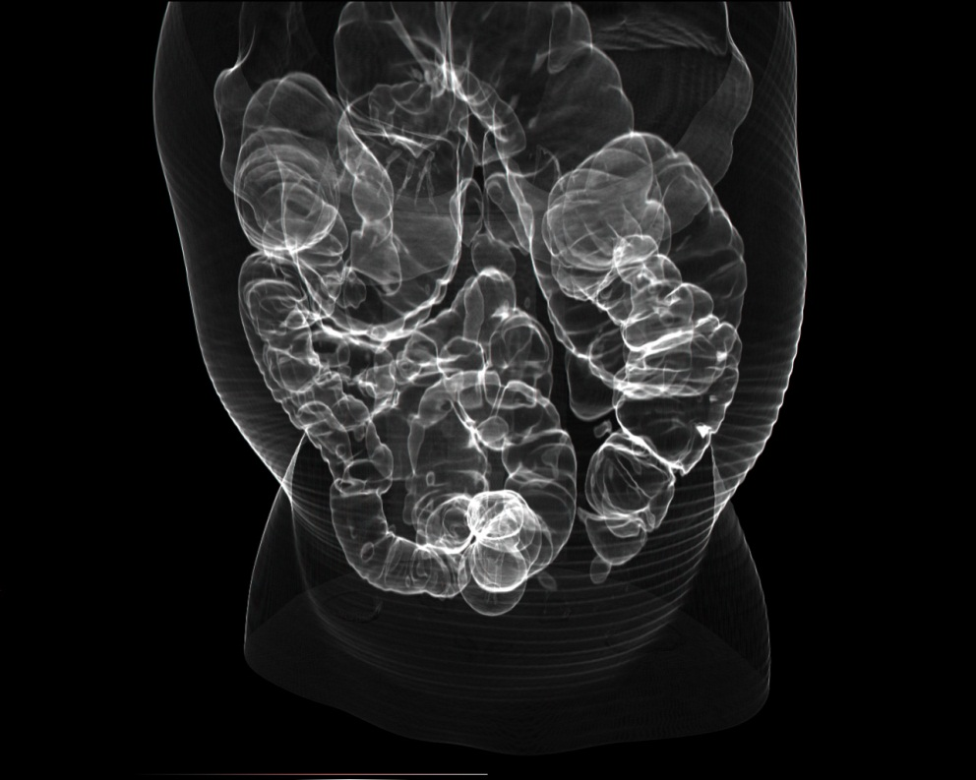
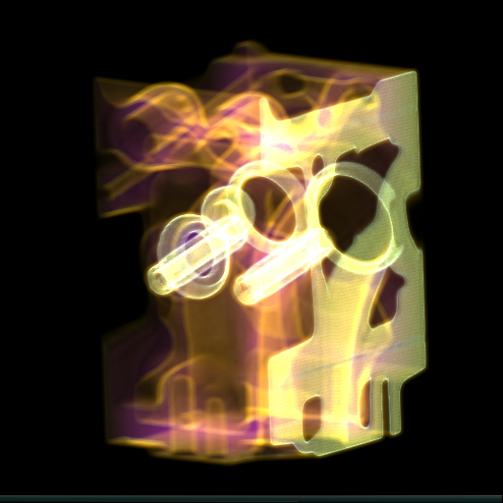
3D Textures
Volume Rendering applications
  Medical datasets
University of Wales Swansea
Benjamin Mora

Slide 29
Other use of
Texture Mapping
University of Wales Swansea
Benjamin Mora

Slide 30
Environment mapping
Useful for simulating/faking reflections & refractions
  Proposed by Blinn and Newell.
The coordinates of the normal on two axes perpendicular to the view direction are used as texture coordinates.
Spherical mapping.
  single image used
Cube mapping.
  6 faces of a cube represent a cube map texture.
  More accurate than spherical mapping.
University of Wales Swansea
Benjamin Mora

Slide 31
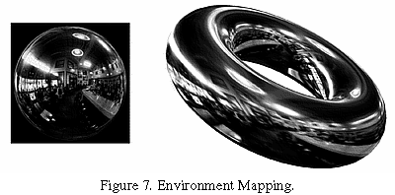
Environment mapping
Spherical mapping. (a single image)
http://www.sgi.com/misc/grafica/texmap/
University of Wales Swansea
Benjamin Mora

Slide 32
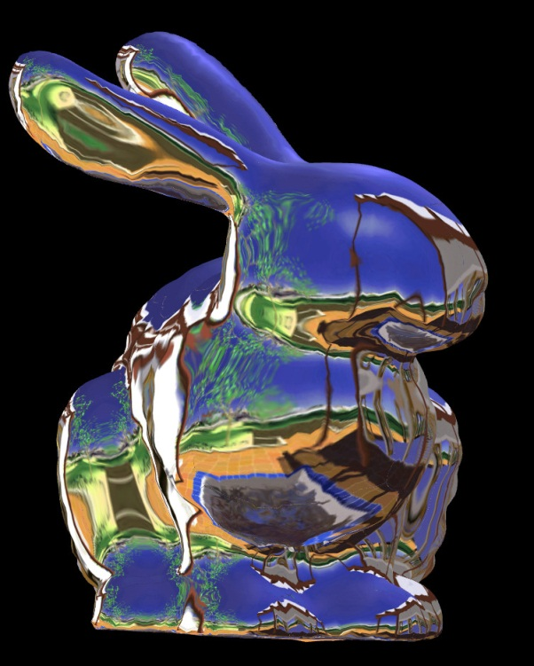


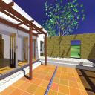
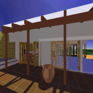
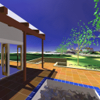
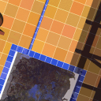
Environment mapping
Cube Mapping
Textures Provided by NVIDIA
University of Wales Swansea
Benjamin Mora

Slide 33
Shadow Mapping
A way to provide more or less accurate shadows!
An alternative to shadow volumes for shadows on graphics hardware.
  Not seen in this course.
University of Wales Swansea
Benjamin Mora

Slide 34
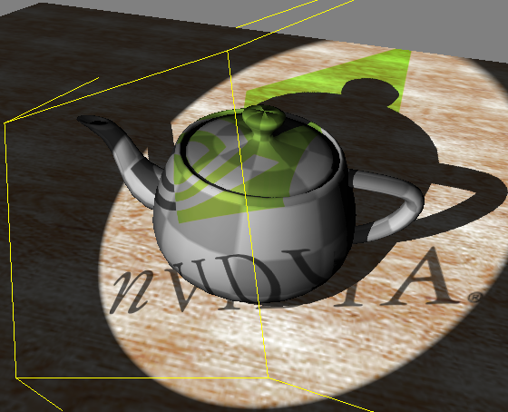
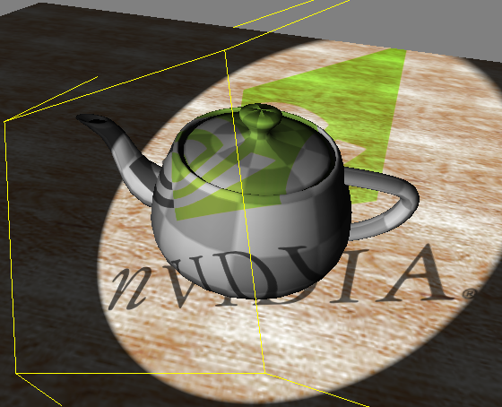
Shadow Mapping
With Shadows
Without Shadows
Cass Everitt, Ashu Rege and Cem Cebenoyan. Hardware Shadow Mapping. Available at: http://developer.nvidia.com/object/hwshadowmap_paper.html
University of Wales Swansea
Benjamin Mora

Slide 35
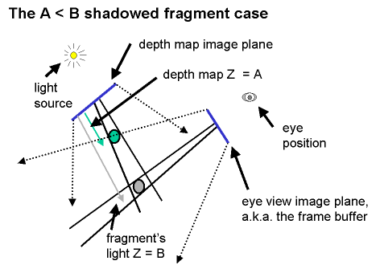
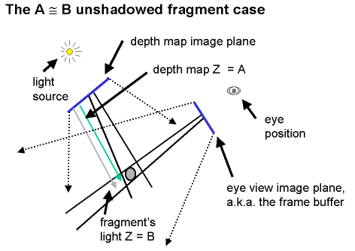
Shadow Mapping
From Mark Kilgard’s shadow mapping presentation at GDC 2001.
Cass Everitt, Ashu Rege and Cem Cebenoyan. Hardware Shadow Mapping. Available at: http://developer.nvidia.com/object/hwshadowmap_paper.html
University of Wales Swansea
Benjamin Mora

Slide 36
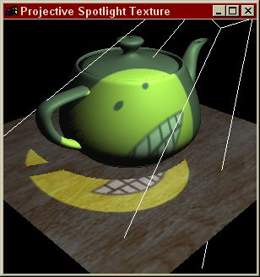
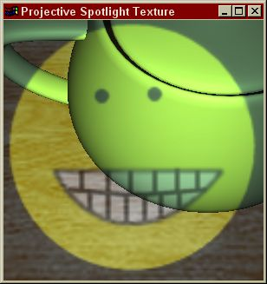
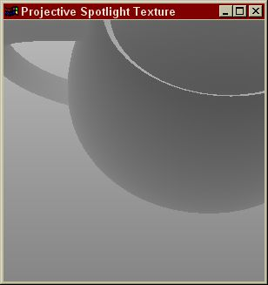
Shadow Mapping
Figure 2. A shadow mapped scene rendered from the eye’s point of view (left), the scene as rendered from the light’s point of view (center), and the corresponding depth/shadow map (right).
Cass Everitt, Ashu Rege and Cem Cebenoyan. Hardware Shadow Mapping. Available at: http://developer.nvidia.com/object/hwshadowmap_paper.html
University of Wales Swansea
Benjamin Mora

Slide 37
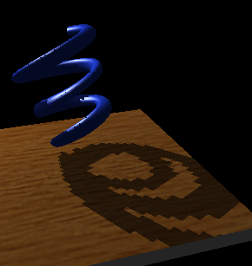
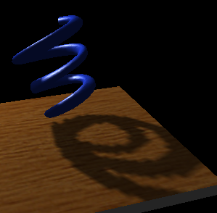
Shadow Mapping
Figure 5. A very low resolution shadow map is used to demonstrate the difference between nearest (left) and linear (right) filtering for shadow maps. Credit: Mark Kilgard.
Cass Everitt, Ashu Rege and Cem Cebenoyan. Hardware Shadow Mapping. Available at: http://developer.nvidia.com/object/hwshadowmap_paper.html
University of Wales Swansea
Benjamin Mora

Slide 38
Shadow Mapping
Render an image (a shadow map) from the viewpoint.
The theoretical position of every pixel in the final image is then compared to the actual shadow map value. (To test its visibility from the light source).
The algorithm must allow for a small margin error in the computation.
Produce aliasing at the penumbra border. Use of high-resolution map is required.
The scene is rendered once per light source.
Simpler than volumetric shadows.
University of Wales Swansea
Benjamin Mora

Slide 39
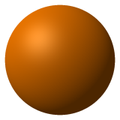
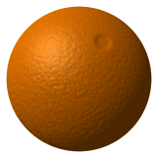
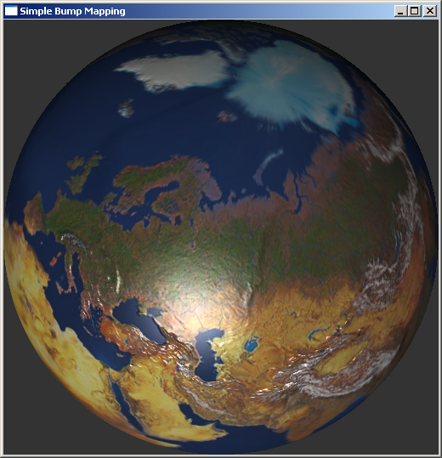
Bump Mapping
Idea (Blinn): Modifying the normal vector of an object before shading to add details to the surface.
The perturbation can be procedural (vertex programs or fragment programs) or texture-based.
http://en.wikipedia.org/wiki/Bump_mapping
Blinn, James F. Simulation of Wrinkled Surfaces, Computer Graphics, Vol. 12 (3), pp. 286-292 SIGGRAPH-ACM (August. 1978).
University of Wales Swansea
Benjamin Mora

